Slide 1
SSL-Secure Socket Layer

Slide 2
SSL (Secure Socket Layer)
TCP: provides a reliable end-to-end service.
TCP & SSL: provides a reliable & secure end-to-end service.
HTTPS: HTTP over SSL (or TLS)
  Typically on port 443 (regular http on port 80)
SSL originally developed by Netscape
subsequently became Internet standard known as TLS (Transport Layer Security)
SSL has two layers of protocols

Slide 3
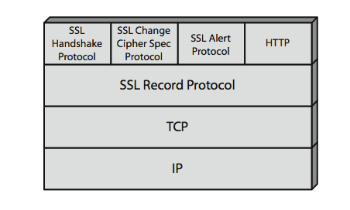
SSL Architecture

Slide 4
SSL Record Protocol Services
SSL Record Protocol provides two services.
Message integrity
  using a MAC with a shared secret key
  similar to HMAC but with different padding
  hash functions: MD5, SHA-1
Message confidentiality
  using symmetric encryption with a shared secret key
  Encryption algorithms: AES, IDEA, RC2-40, DES-40, DES, 3DES, RC4-40, RC4-128

Slide 5
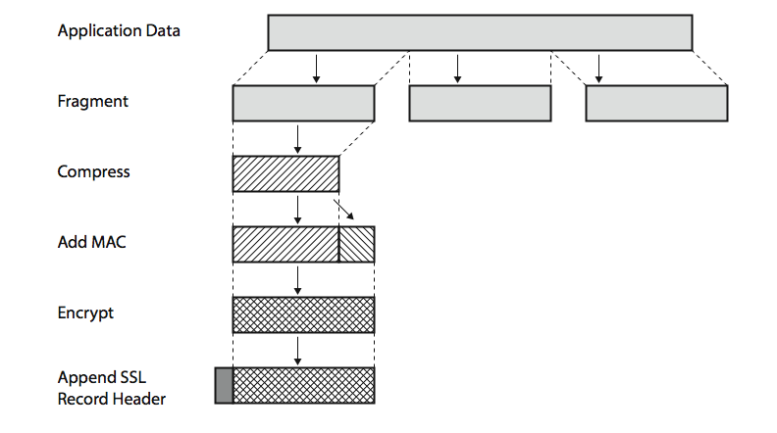
SSL Record Protocol Operation
≤ 2¹⁴ bytes
(optional; default: null)

Slide 6
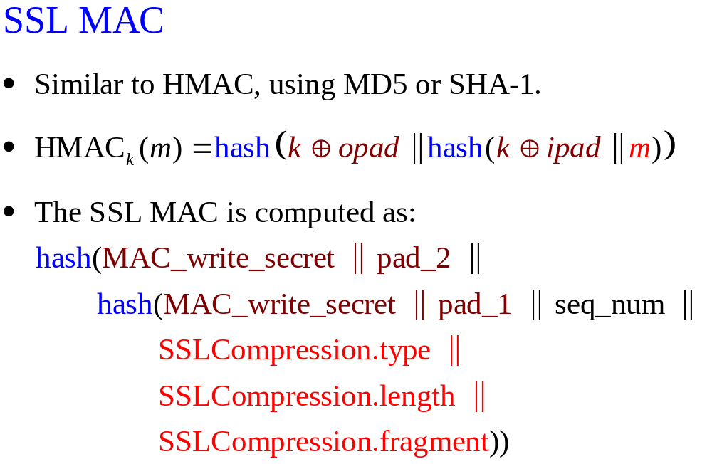

Slide 7
SSL Handshake Protocol
Allows server & client to:
  authenticate each other
  to negotiate encryption & MAC algorithms and keys
Comprises a series of messages exchanged in phases:
  Establish Security Capabilities (to agree on encryption, MAC, and key-exchange algorithms)
  Server Authentication and Key Exchange
  Client Authentication and Key Exchange
  Finish

Slide 8
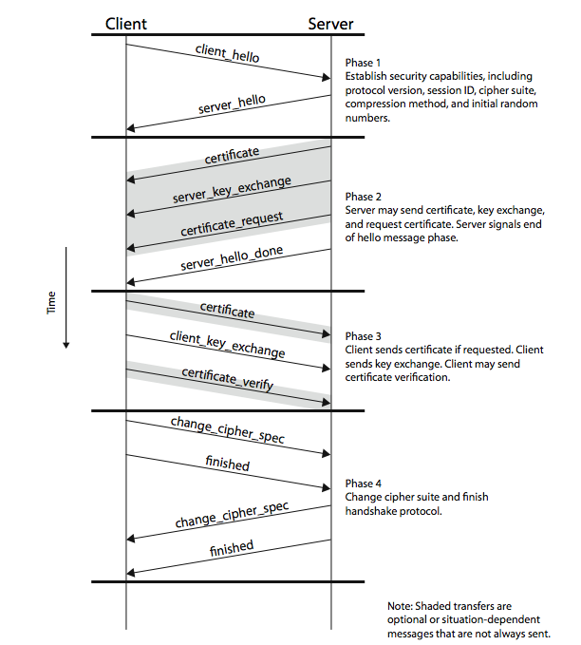
Stallings
Figure 17.6

Slide 9
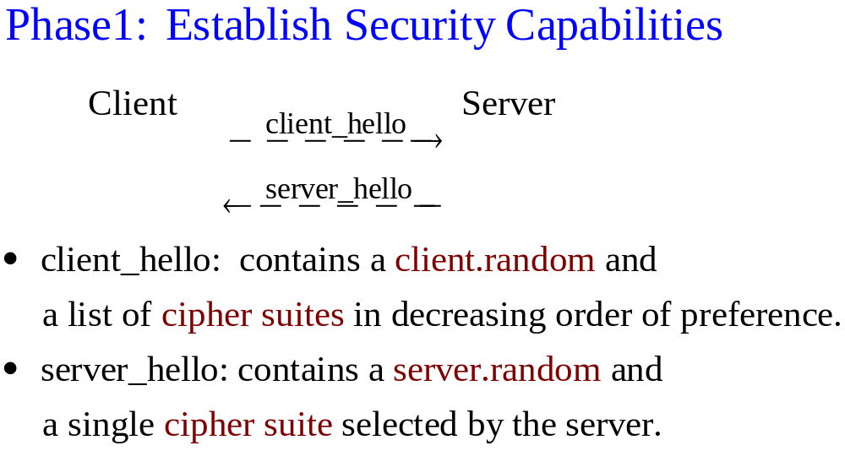

Slide 10
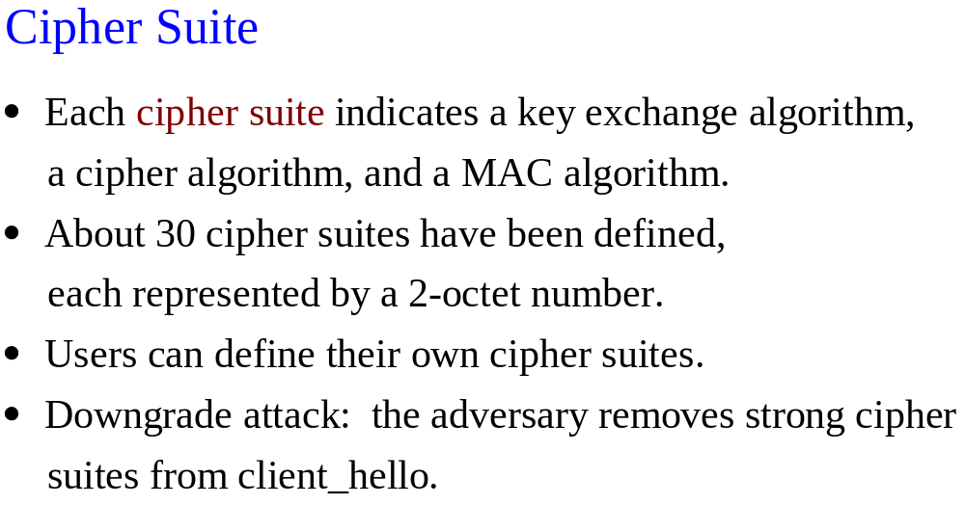

Slide 11
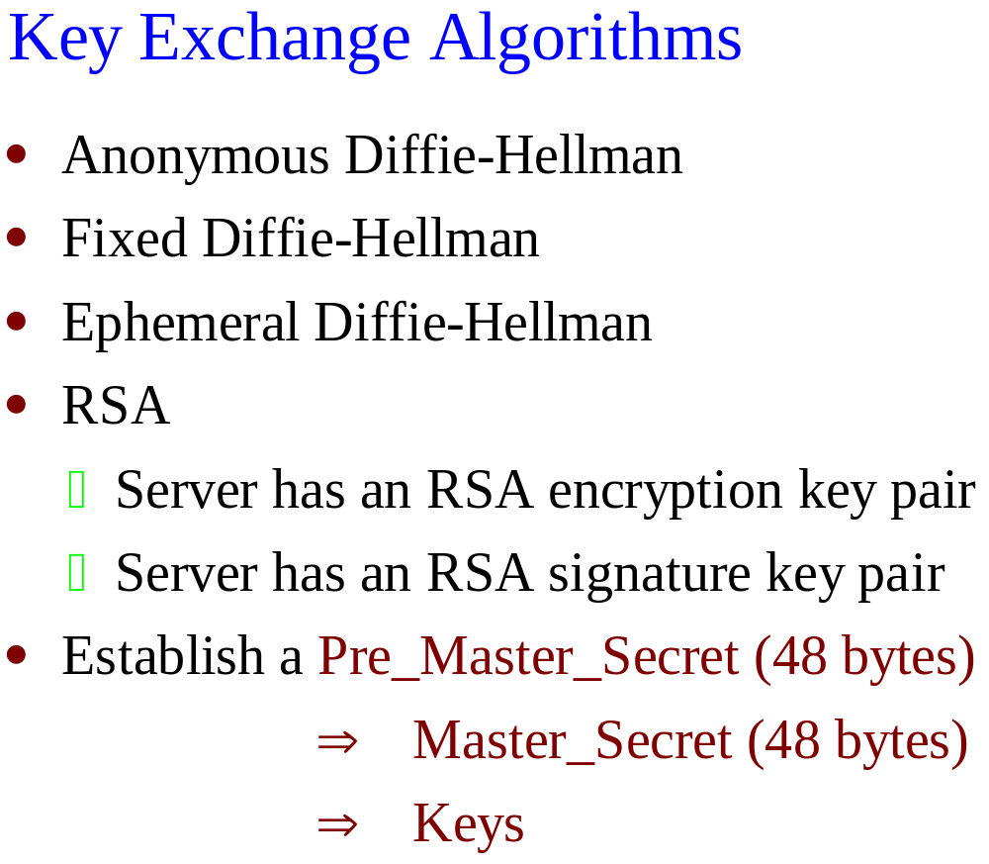

Slide 12
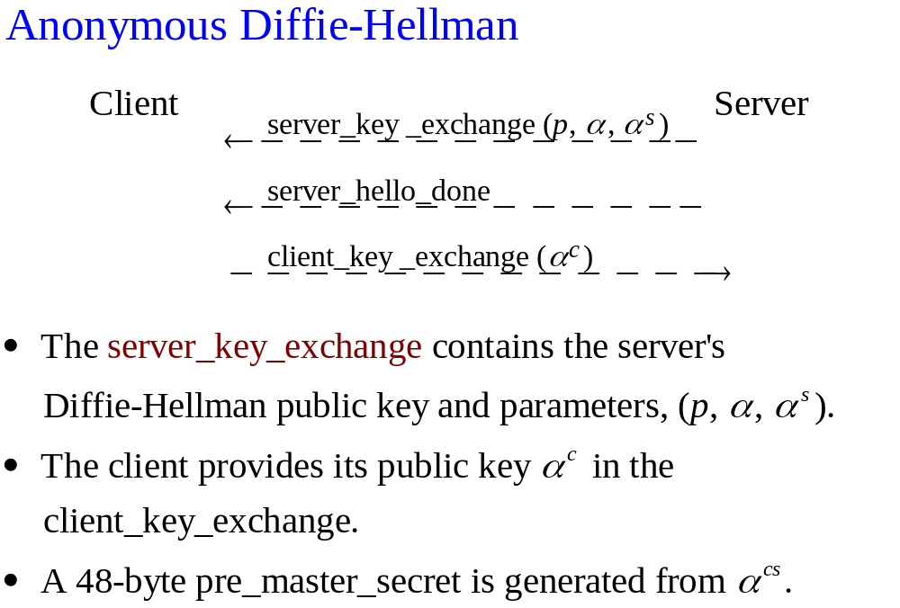

Slide 13
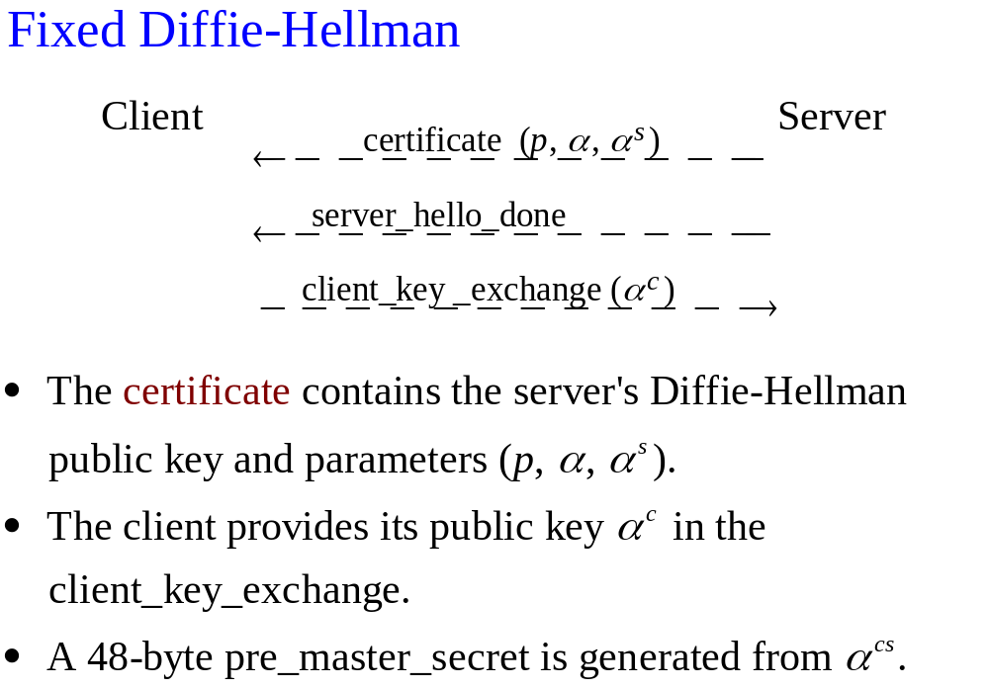

Slide 14
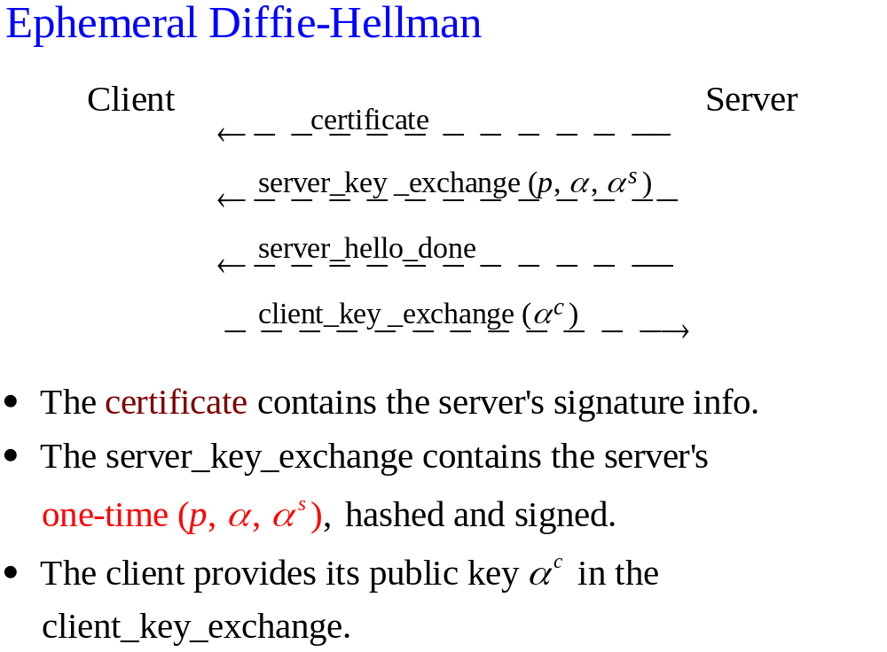

Slide 15
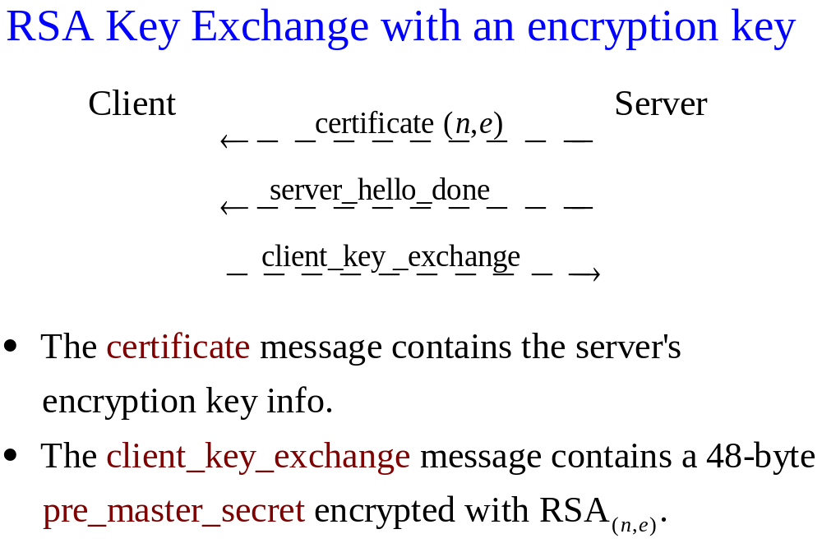

Slide 16
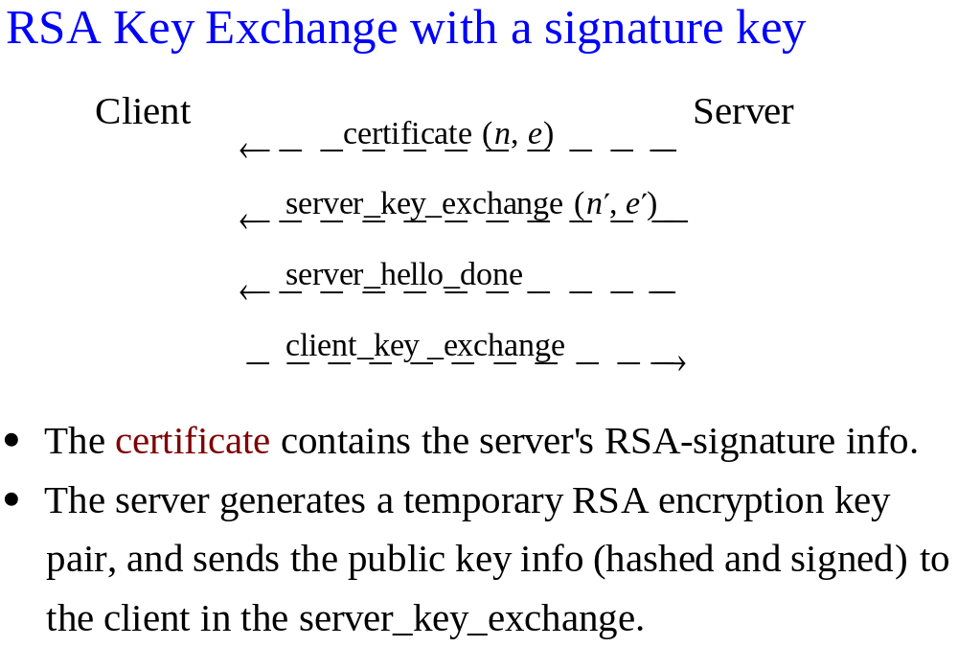

Slide 17
Client Authentication
The server may request a certificate from the client.
The client will send a certificate message or a no_certificate alert.

Slide 18
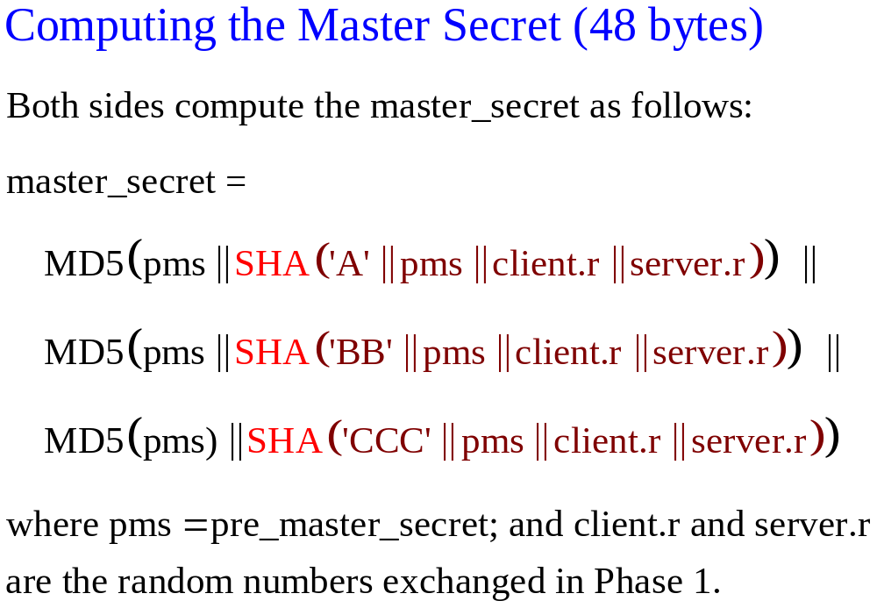

Slide 19
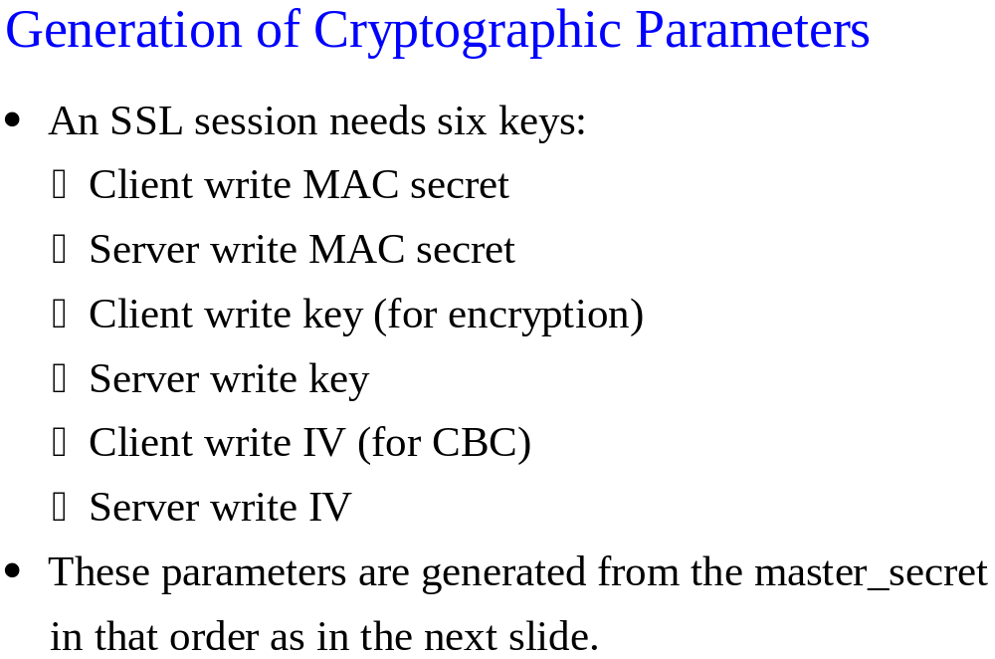

Slide 20
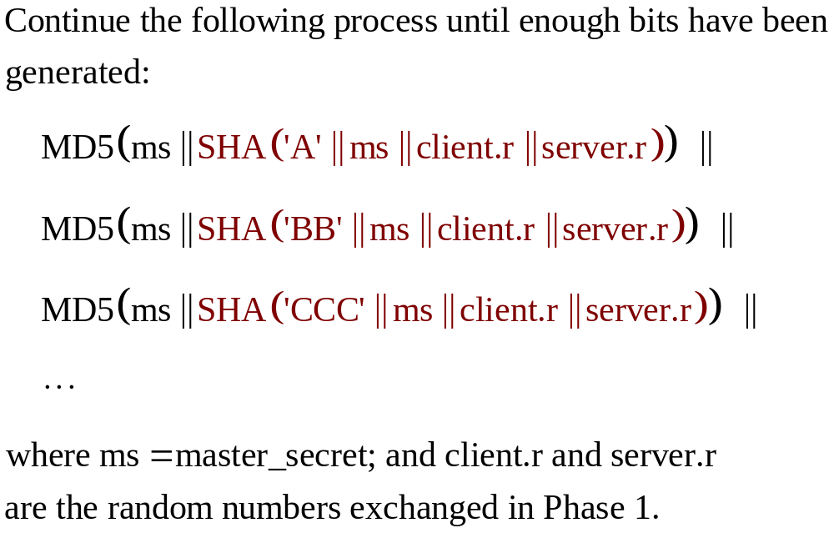

Slide 21
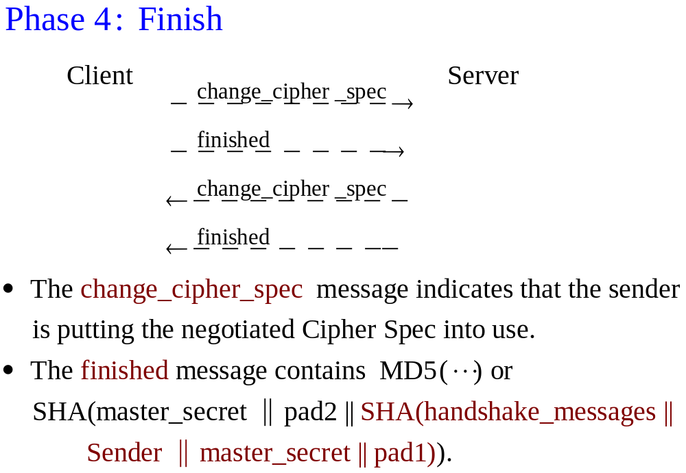

Slide 22
SSL Session and Connection
SSL was designed to work with HTTP 1.0 which tended to open a lot of TCP connections between the same client and server.
SSL assumes a session is a relatively long-lived thing from which many (transient) connections can be cheaply derived.
1 session = 1 or more connections

Slide 23
SSL Session
Created by the Handshake Protocol.
Parameters:
  Session ID
  Compression method
  Cipher spec (encryption and hash algorithm)
  Master secret
  Is resumable

Slide 24
SSL Connection
Based on an underlying TCP connection
Associated with a session
Parameters:
  Server and client random
  Server and client write MAC secret
  Server and client write secret
  Server and client IV (if CBC is used)
  Sequence number
Closed by a close_notify from each side

Slide 25
Session Resumption
In handshaking, the client_hello contains a session ID:
  If session ID = 0, start a new session
  If session ID = x (and session x is resumable):
    start a new connection of session x
    (or change parameters of a current connection of session x)
    Skip key exchange
    Use the session’s master secret to generate keys

Slide 26
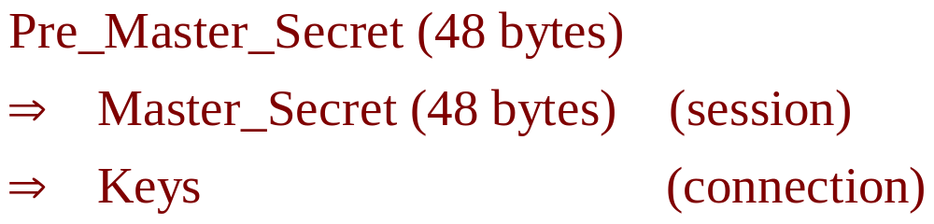
Master secret vs. pre-master secret
Why?
Note: even if we use pre_master_secret to generate keys, each connection will have its own set of keys.

Slide 27
Pre_master_secret
  computed for each session during handshaking
  could be the same for all sessions
  is not stored (so safe)
Master_secret
  is stored for the lifetime of the session
  may be compromised
  If compromised, damage limited to a session
What if pre_master_secret is used to generate keys?

